Slide 1


PART 5. Future Prospect
For the international mail
Now : sender’s name
sender’s address
region (continents and countries)
Future : maybe the receiver’s name
receiver’s address
just like the domestic mail

Slide 2
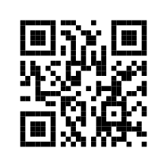
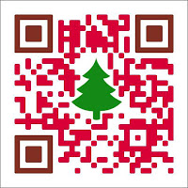
PART 5. Future Prospect
For the customized QR-code
Algorithm
After
Now
Or they can even upload the picture they like!

